Slide 1

CI/CD PipeLine
AWS-DevOps
Project By S.Kripashankar (B.Tech IT)

Slide 2
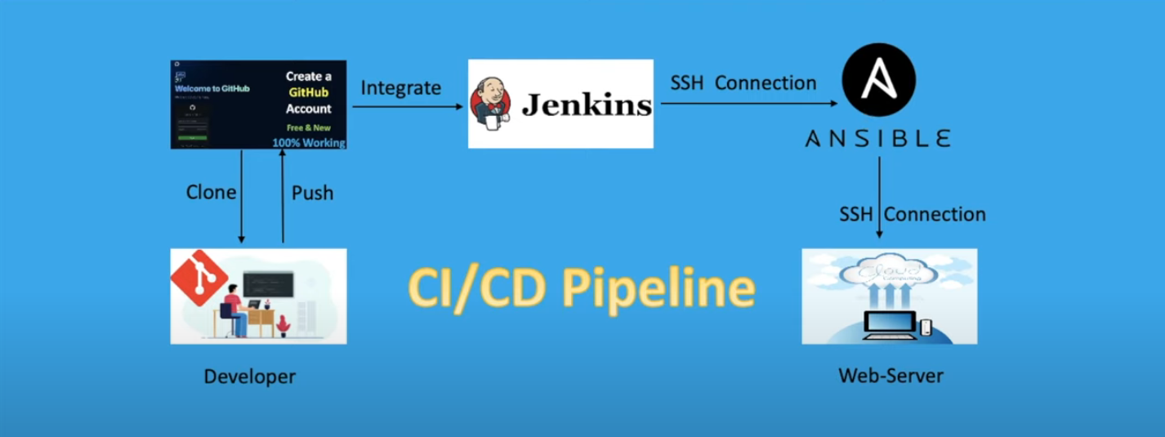
CI/CD Pipeline Flowchart
Modules Used in this Project.
- Ansible
- Jenkins
- Git

Slide 3
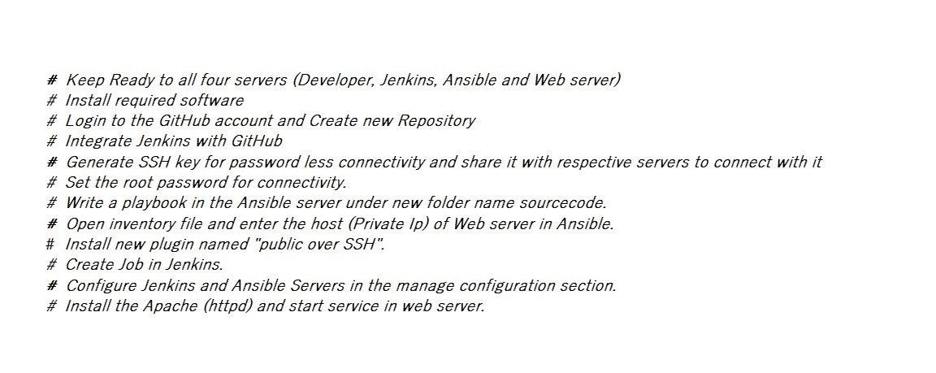
To Do List

Slide 4
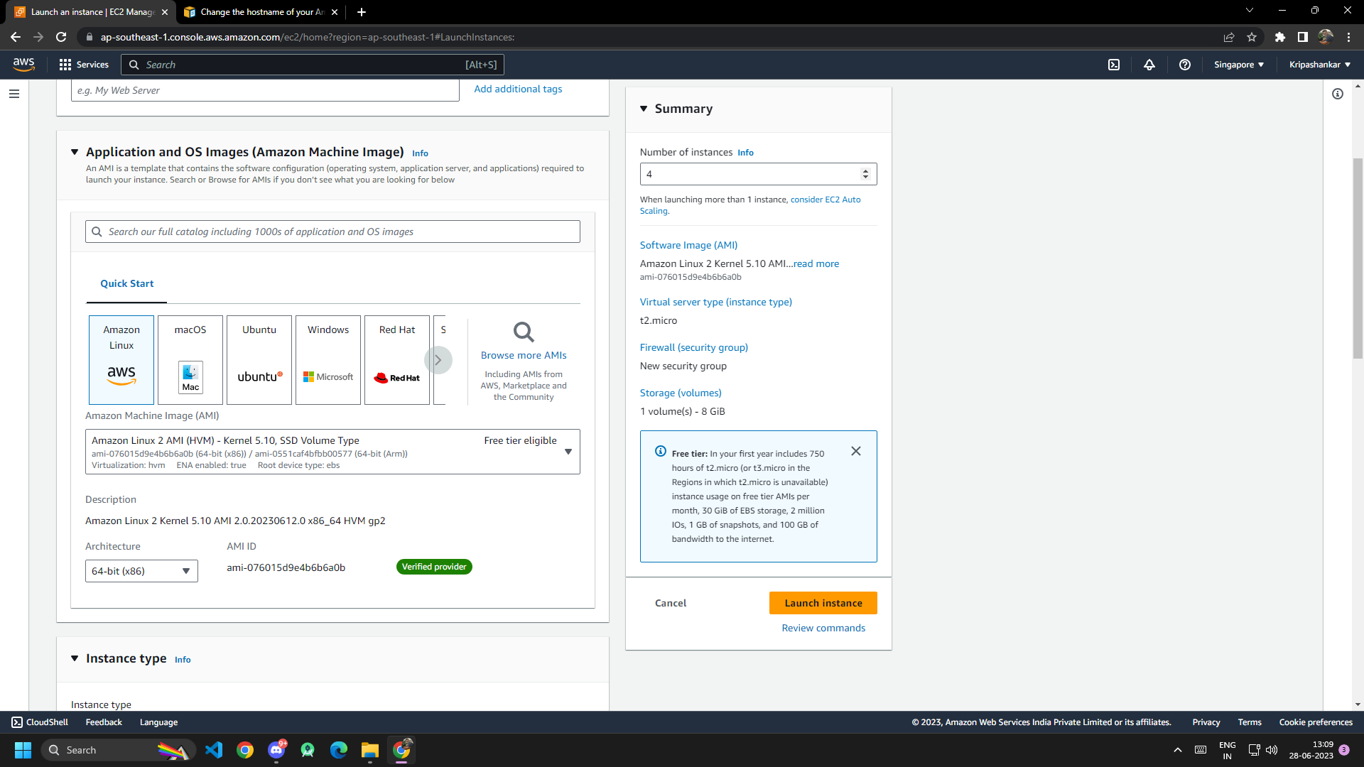
Creating Instances in EC2
1.Go to EC2 create 4 instances accordingly.
2. At Application and OS images(AMI)
Select AWS Linux 2 AMI
(HVM).

Slide 5
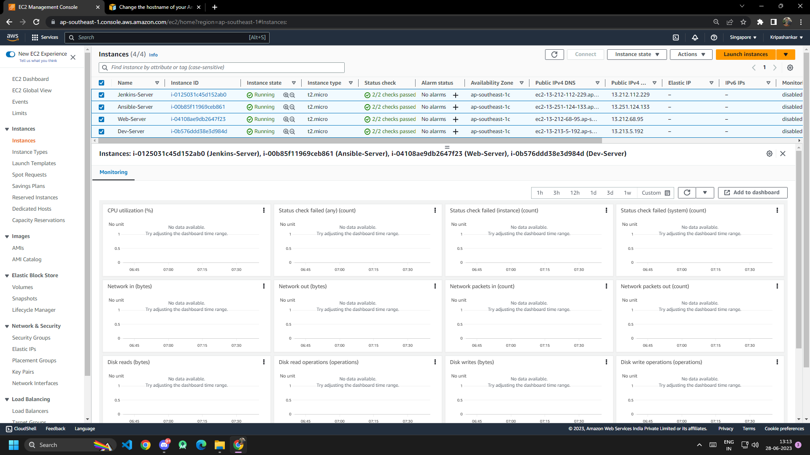
Renaming The Instances
Rename the instances accordingly as we need four servers to connect with the CI/CD
Pipeline.
The List of the Servers
Ansible-Server
Jenkins-Server
web-Server
Dev-Server

Slide 6
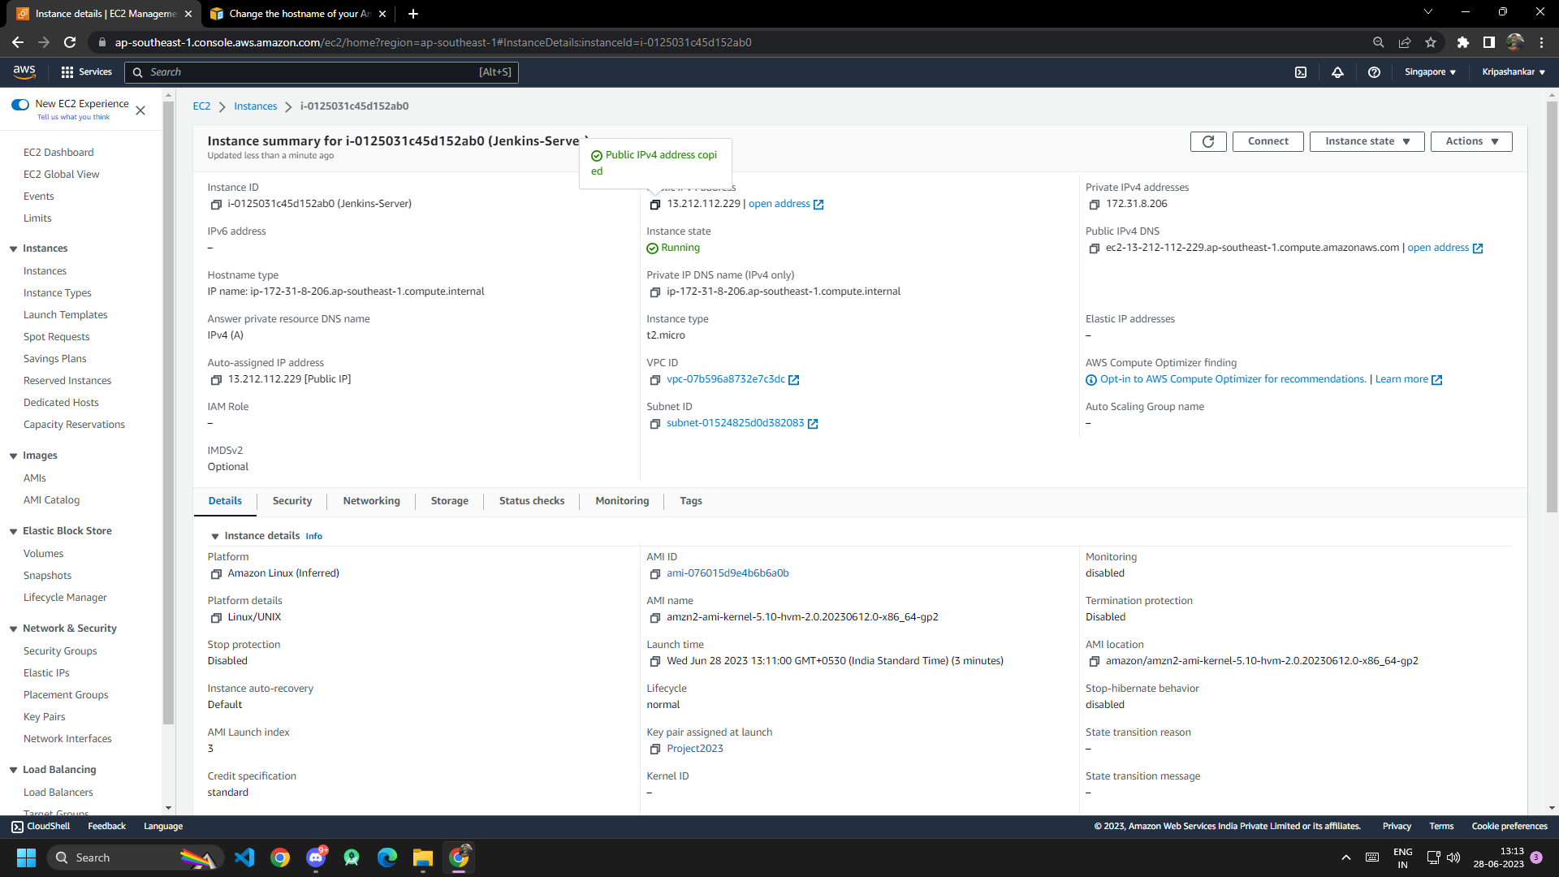
Copy the Public IP of the Jenkins Server.

Slide 7
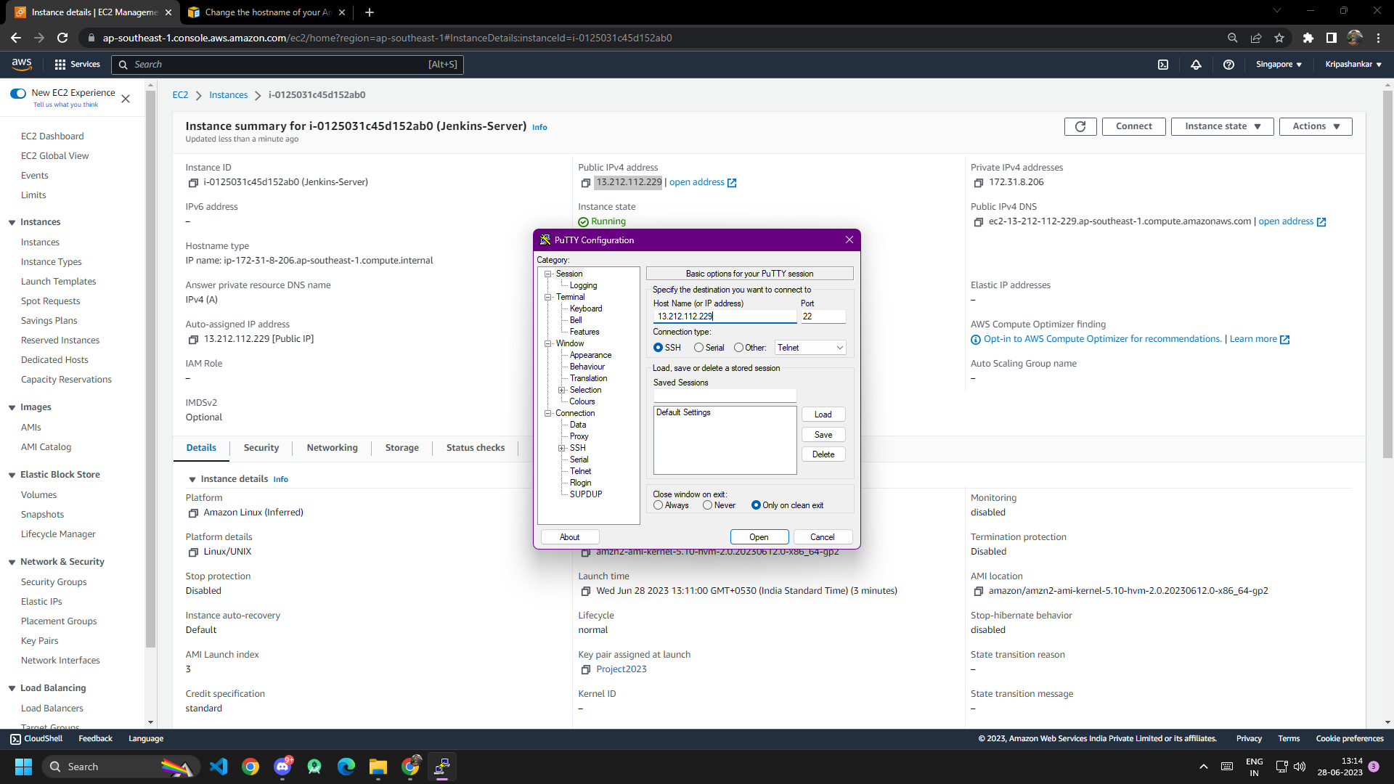
Open Putty And Paste the Jenkins Public IP in the Host Name.

Slide 8
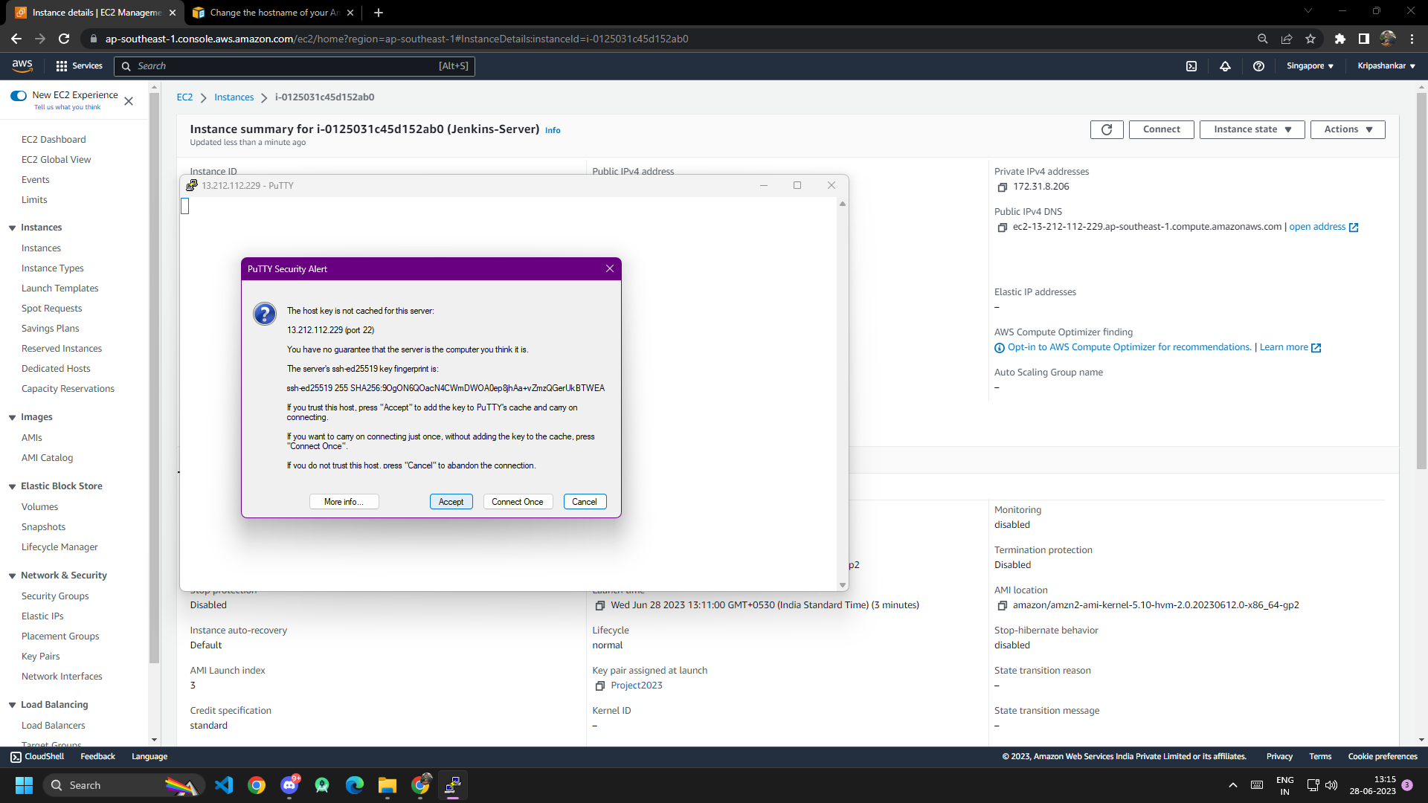
Using Putty the Jenkins instance is connected successfully.

Slide 9
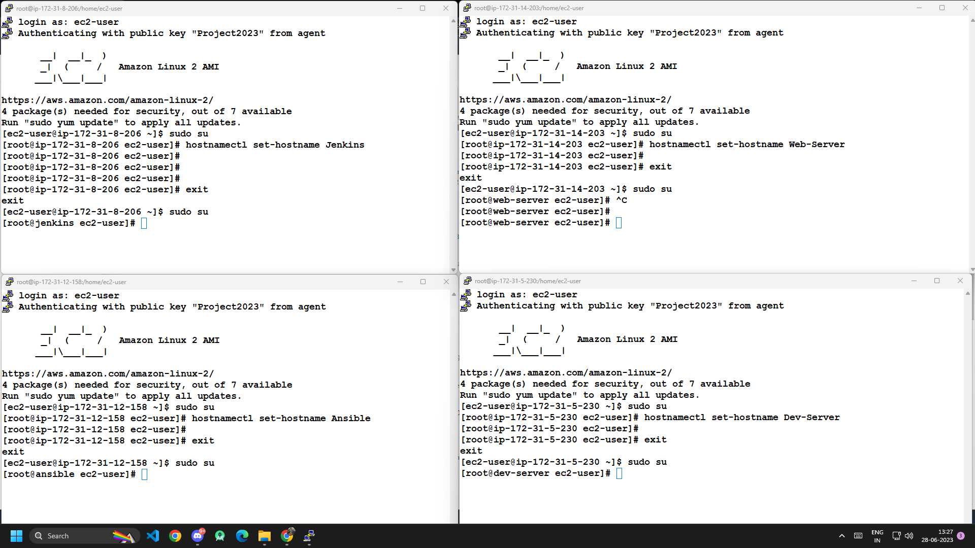
Likewise all the other servers are connected using putty accordingly.

Slide 10
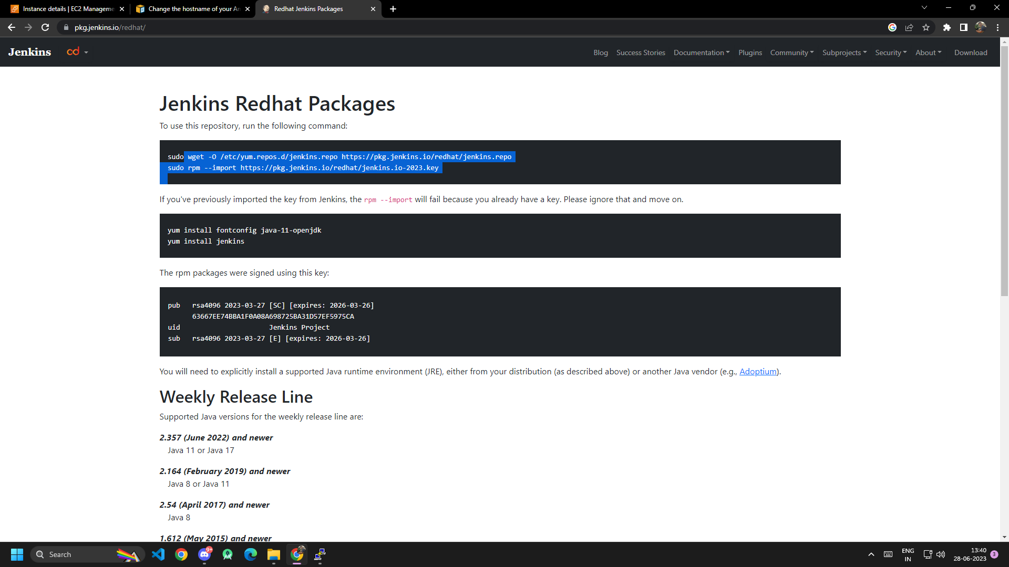
Install Jenkins from the official site using the wget command given in the site.

Slide 11
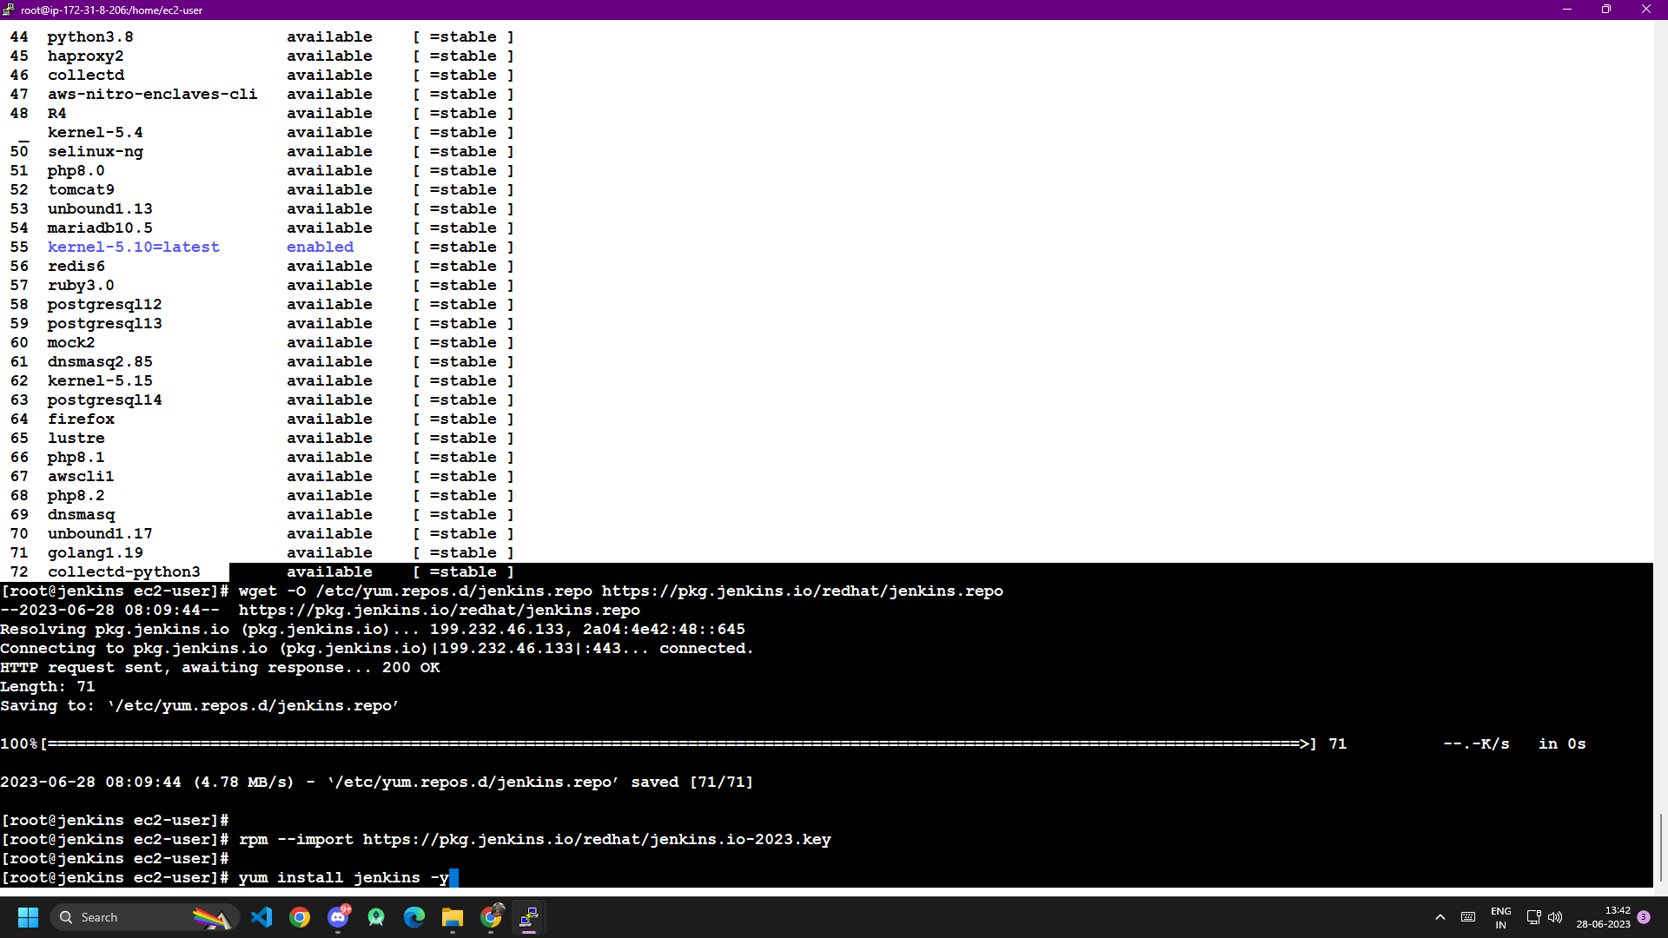
Now Jenkins successfully installed in the Jenkins-Server.

Slide 12
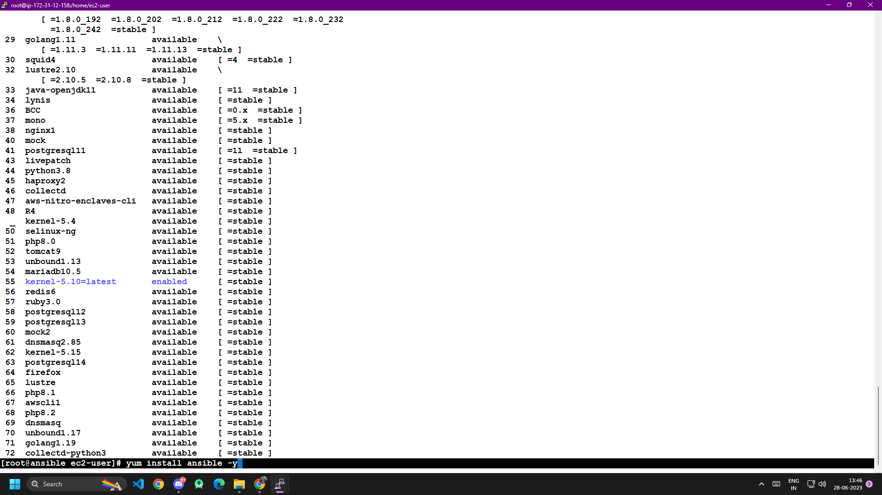
Installing Ansible in Ansible Server.

Slide 13
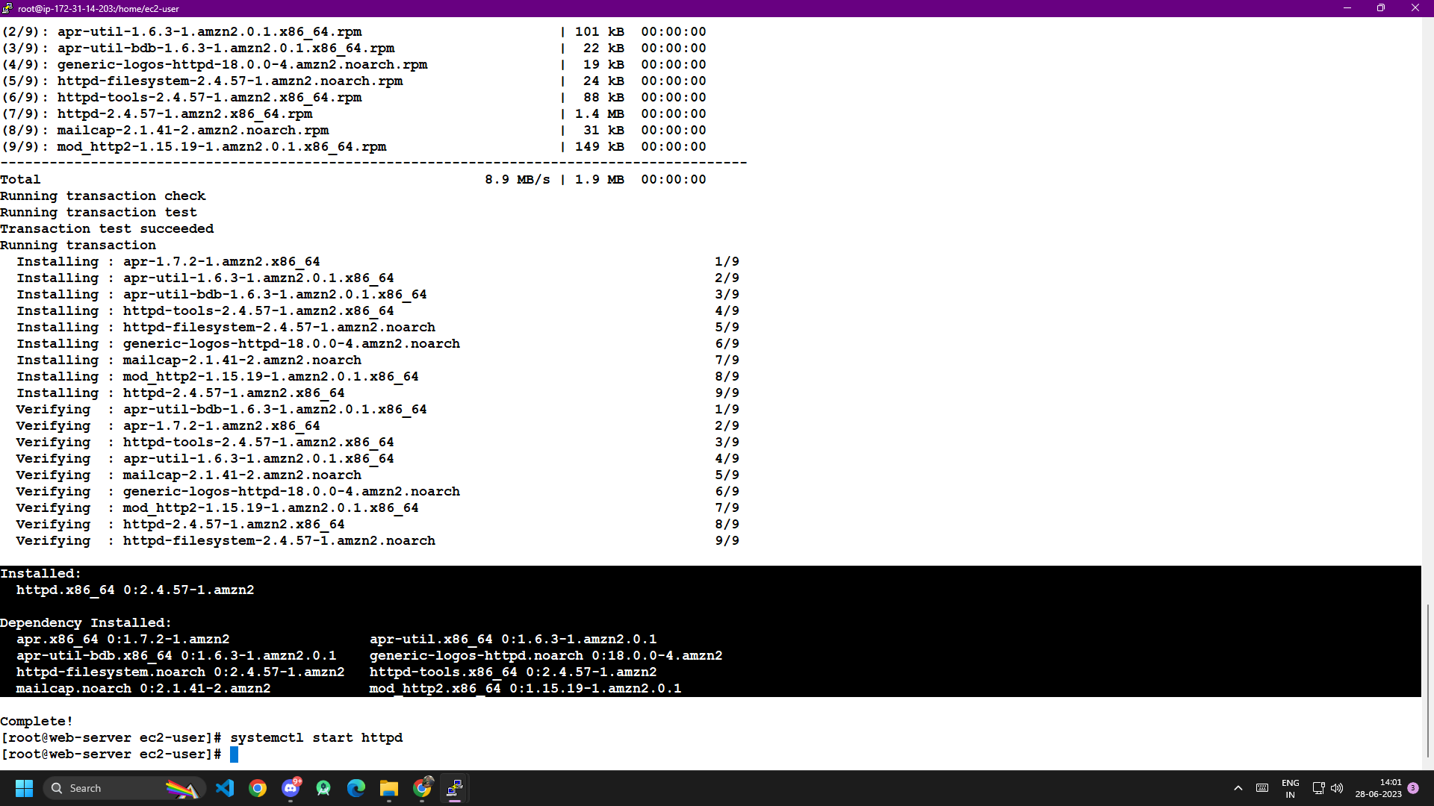
Apache service is been installed successfully in the webserver.

Slide 14
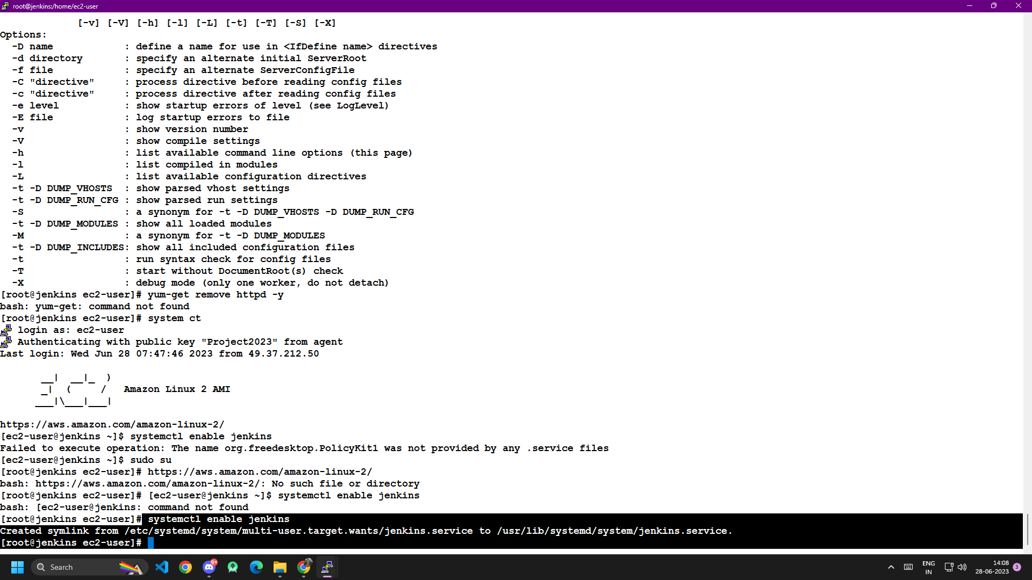
Enabling Jenkins in Jenkins Server .

Slide 15
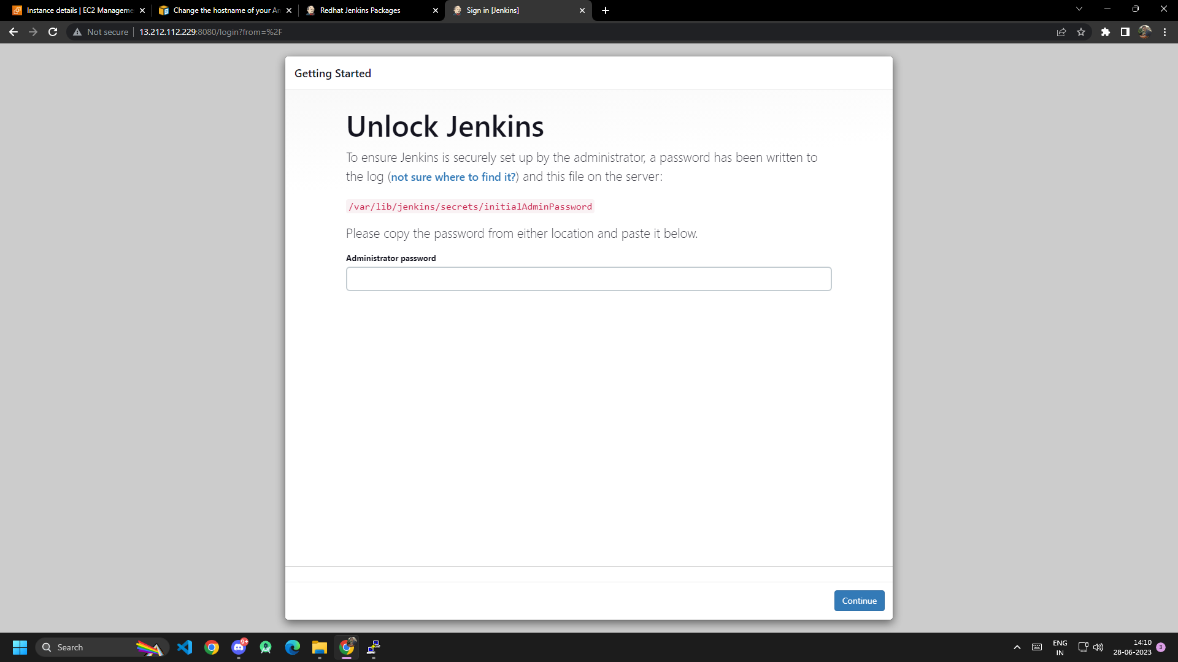
Jenkins is successfully started and enabled.

Slide 16
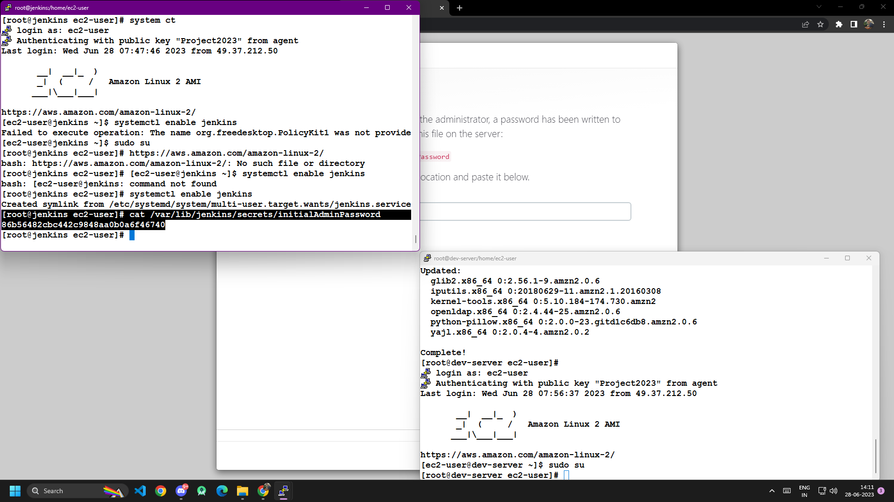
Jenkins initial Admin password is generated successfully
by using this we’ll be able to enter initation page of Jenkin.

Slide 17
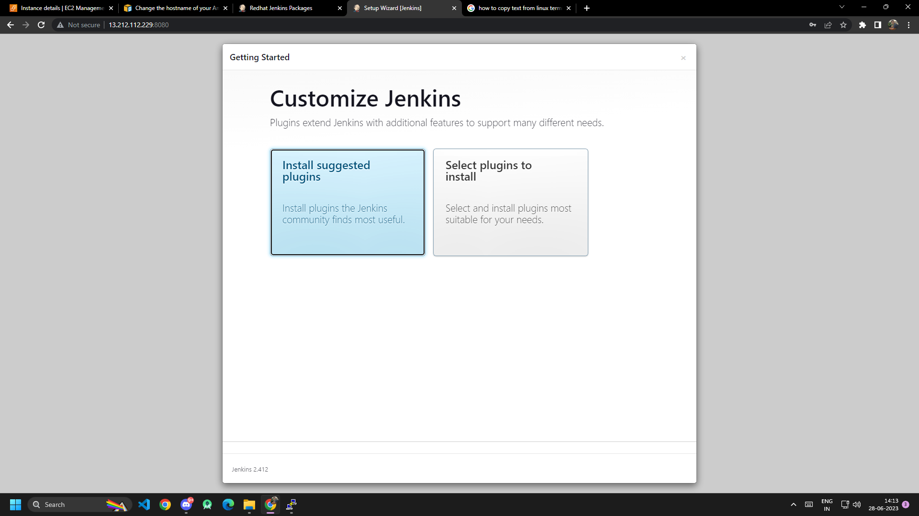
Lets gets started with Install suggested Plugins in Jenkins.

Slide 18
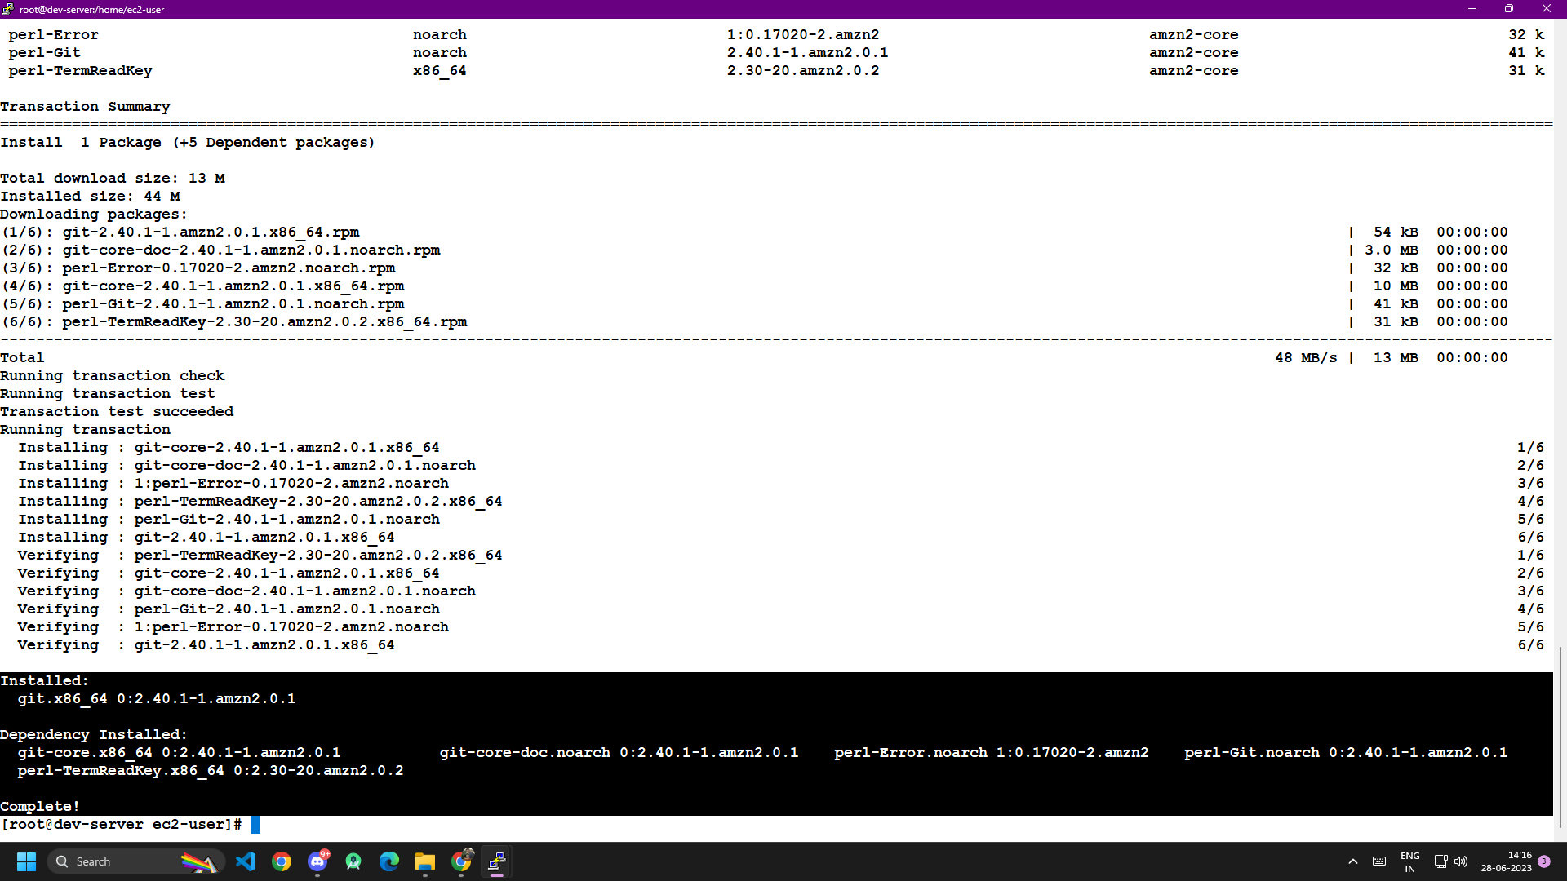
Installing Git in Dev-Server Succesfully.

Slide 19
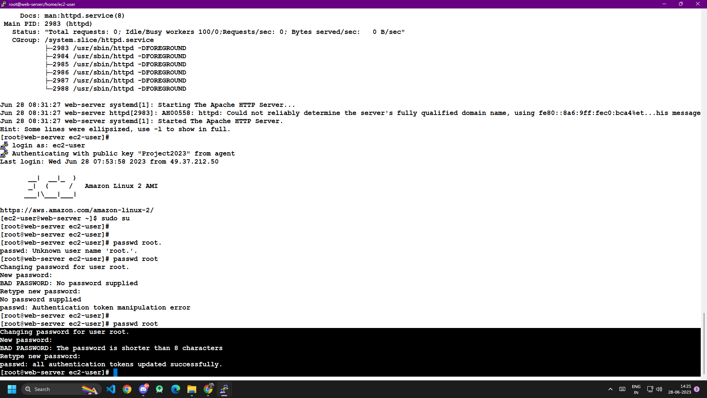
Changing root password in Web-Server is changed.
Likewise the root password of all other servers are changed accordingly.

Slide 20
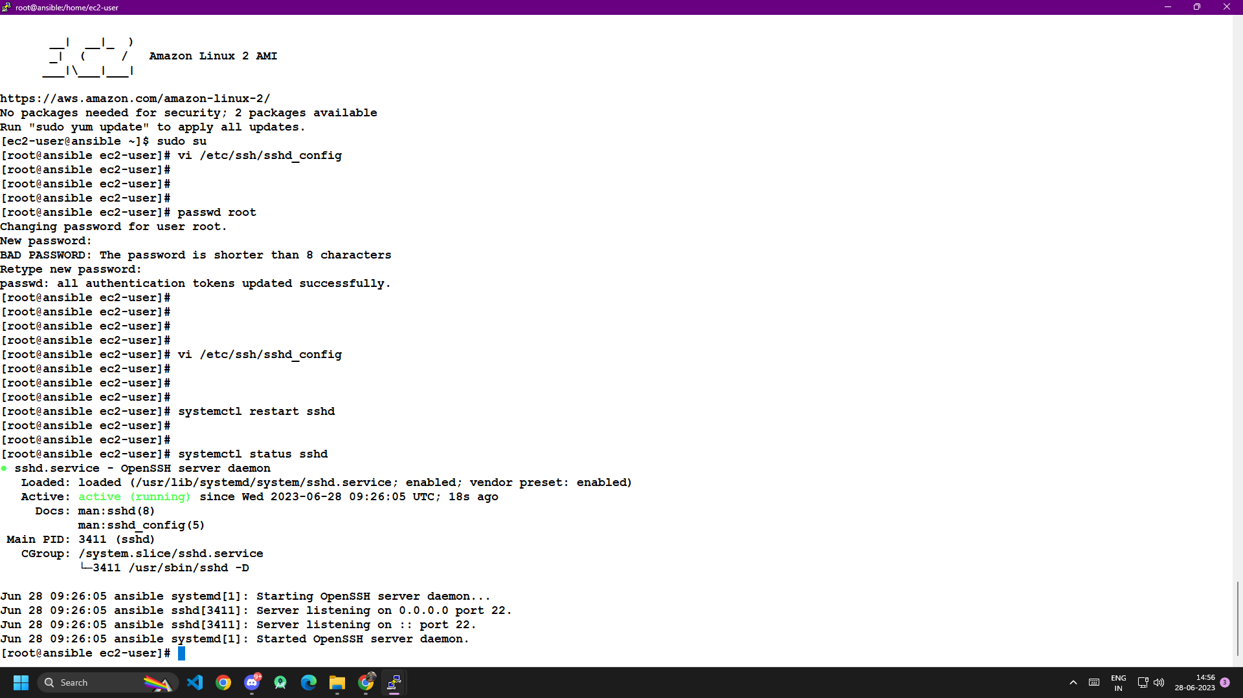
Editing sshd_config to access PasswordAuthenticatin to Yes.

Slide 21
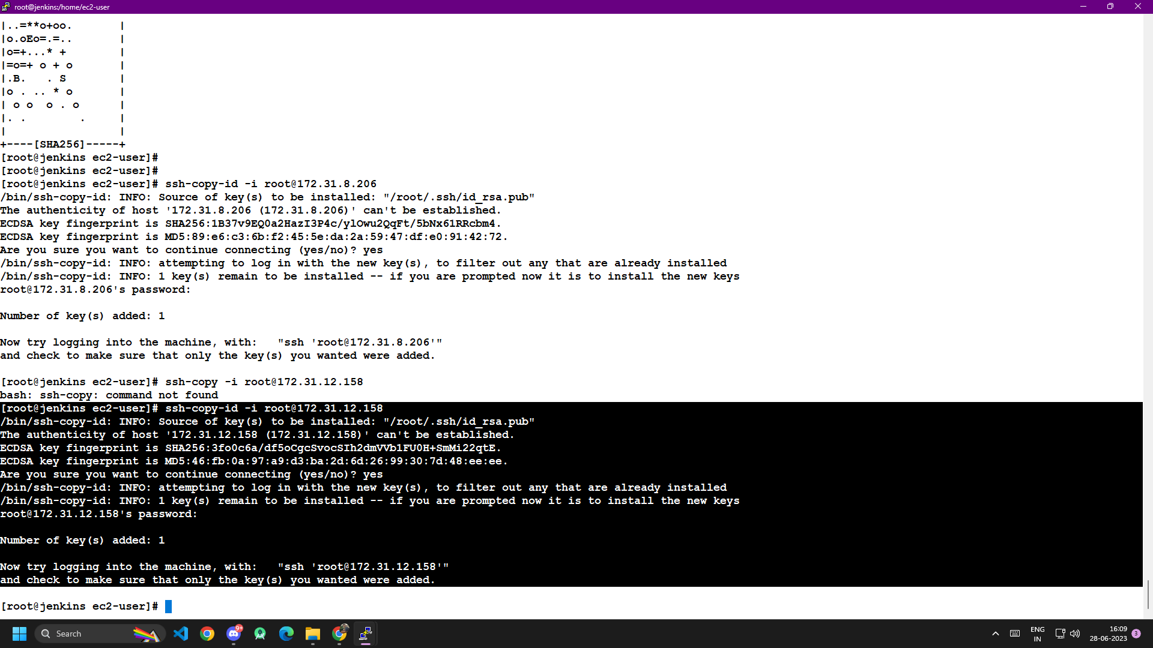
Establishing ssh connection with Jenkins and Ansible.

Slide 22
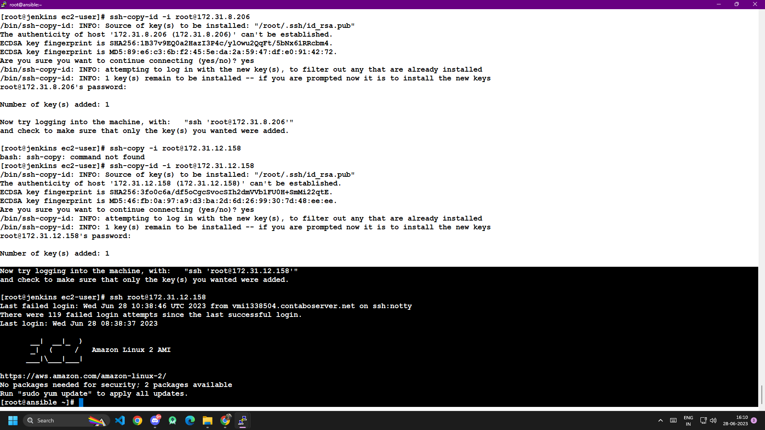
ssh successfully Installed between the Jenkins and Ansible.

Slide 23
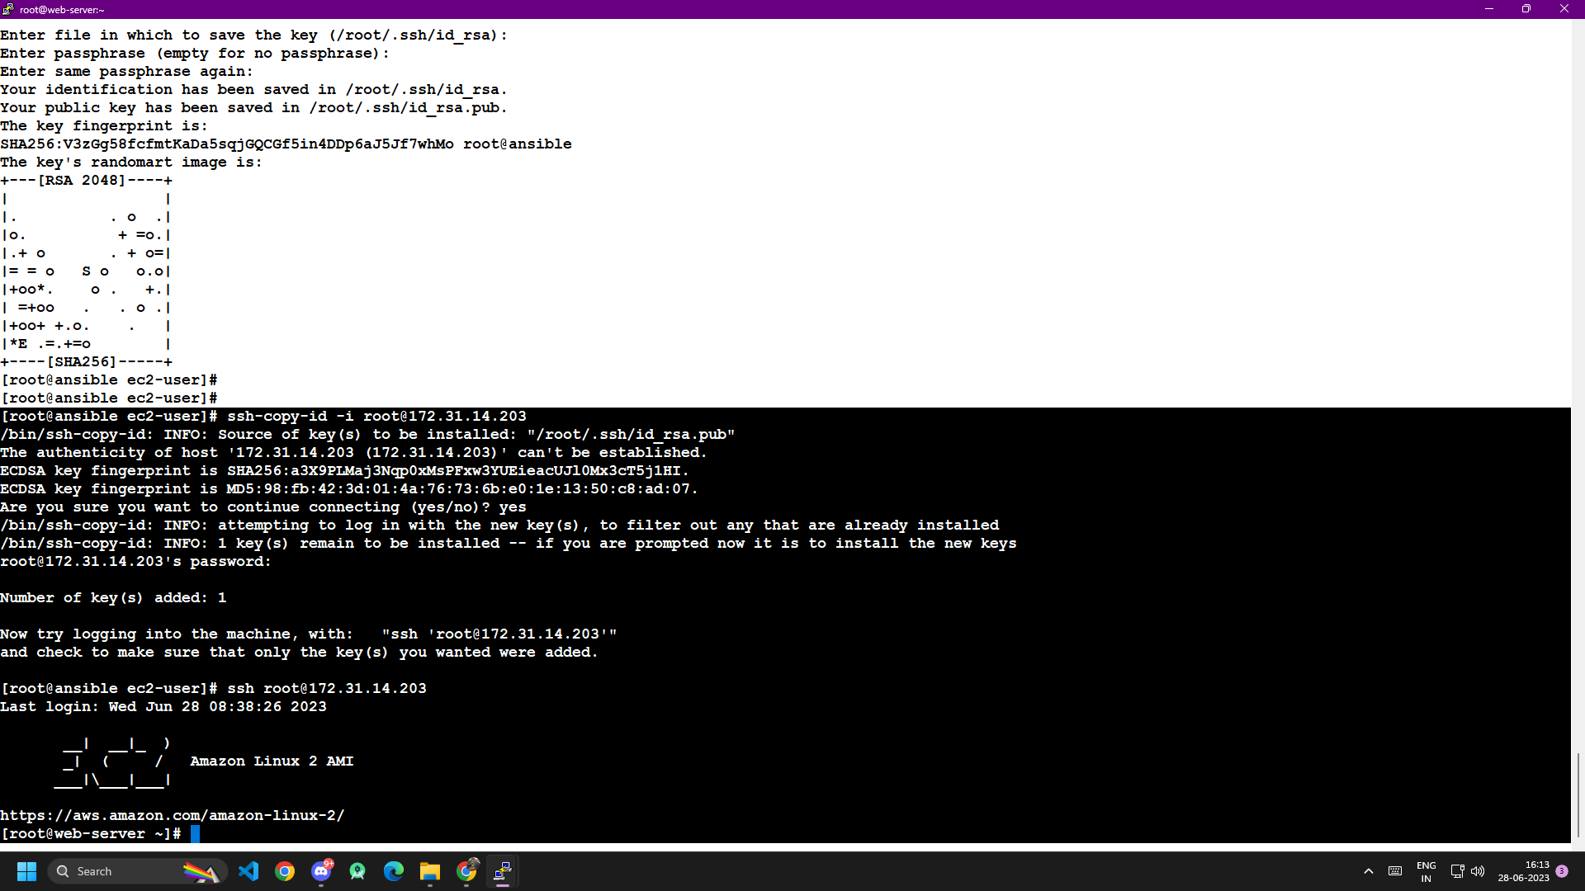
Establishing ssh connection with Ansible and Web-Server Successfully.

Slide 24
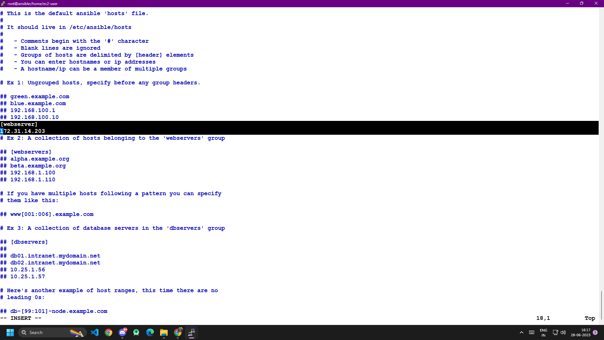
In the ansible cfg file add Webserver’s Private IP.

Slide 25
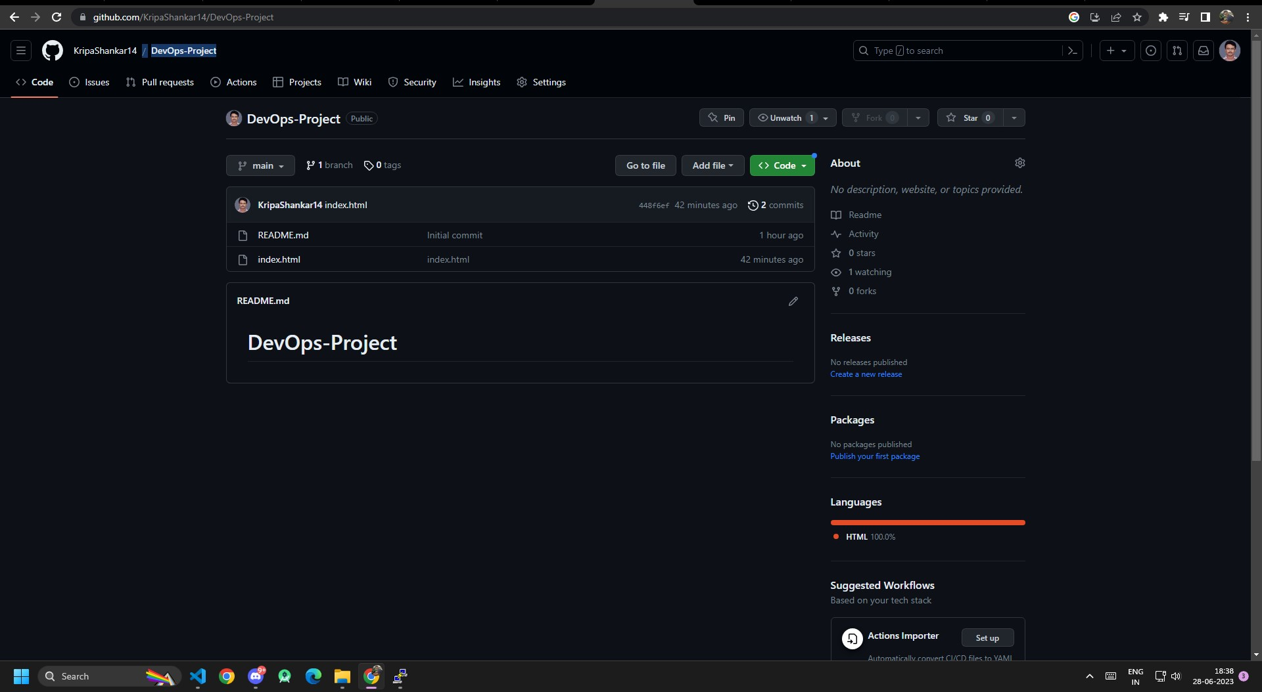
Open Github create a new repo and name its DevOps-Project
And add index.html file contains a content.

Slide 26
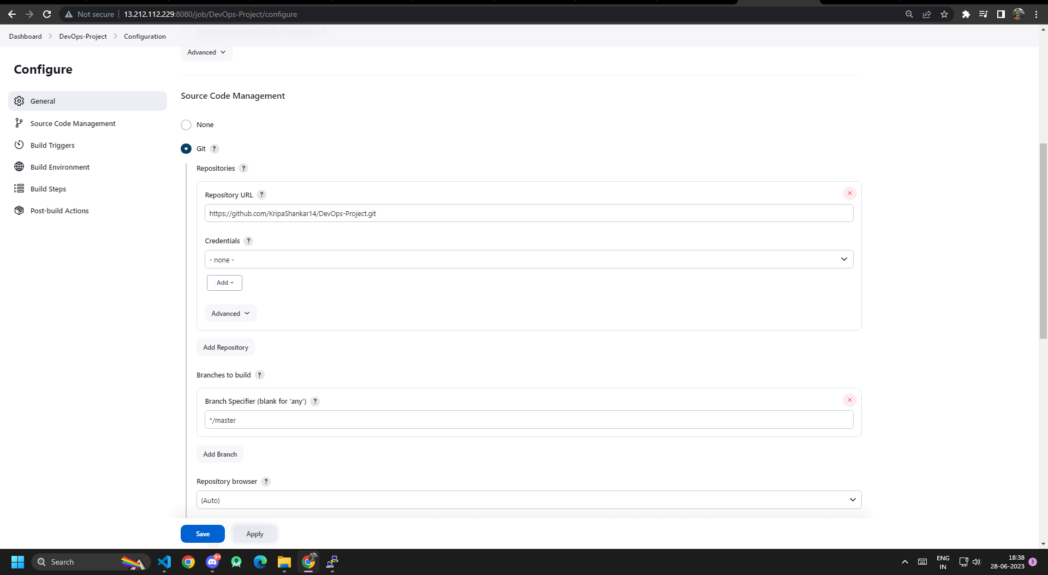
Open Jenkins > new Item > add the git url in the Repo url.

Slide 27
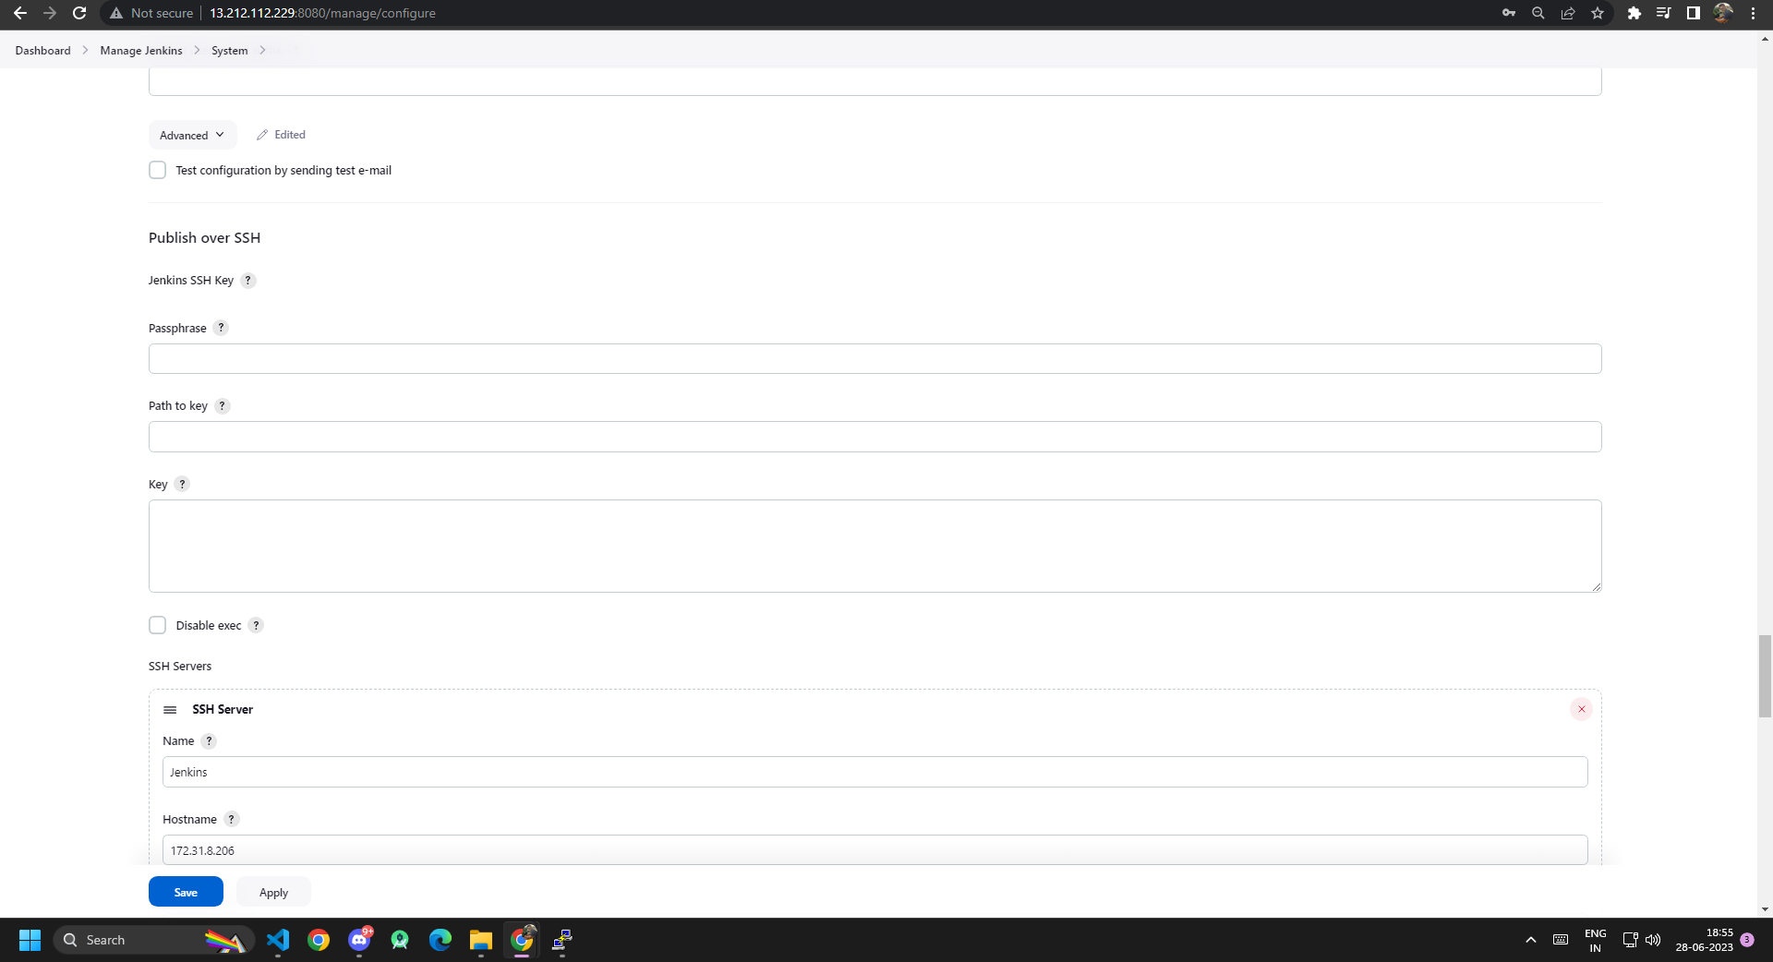
Adding SSH server – jenkin @ privatekey of jenkins.

Slide 28
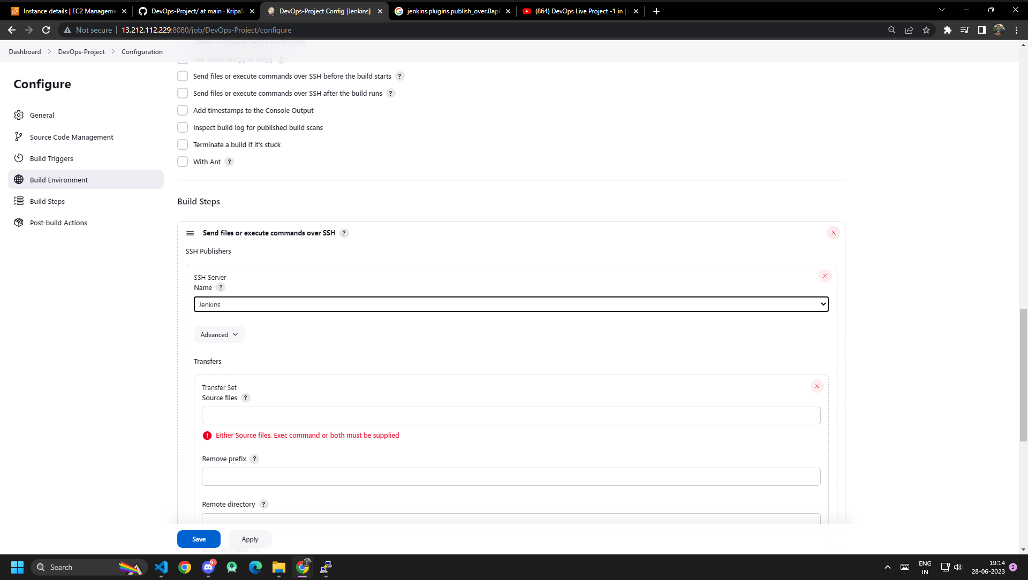
At Built Steps add SSH Publishers –Jenkins.

Slide 29
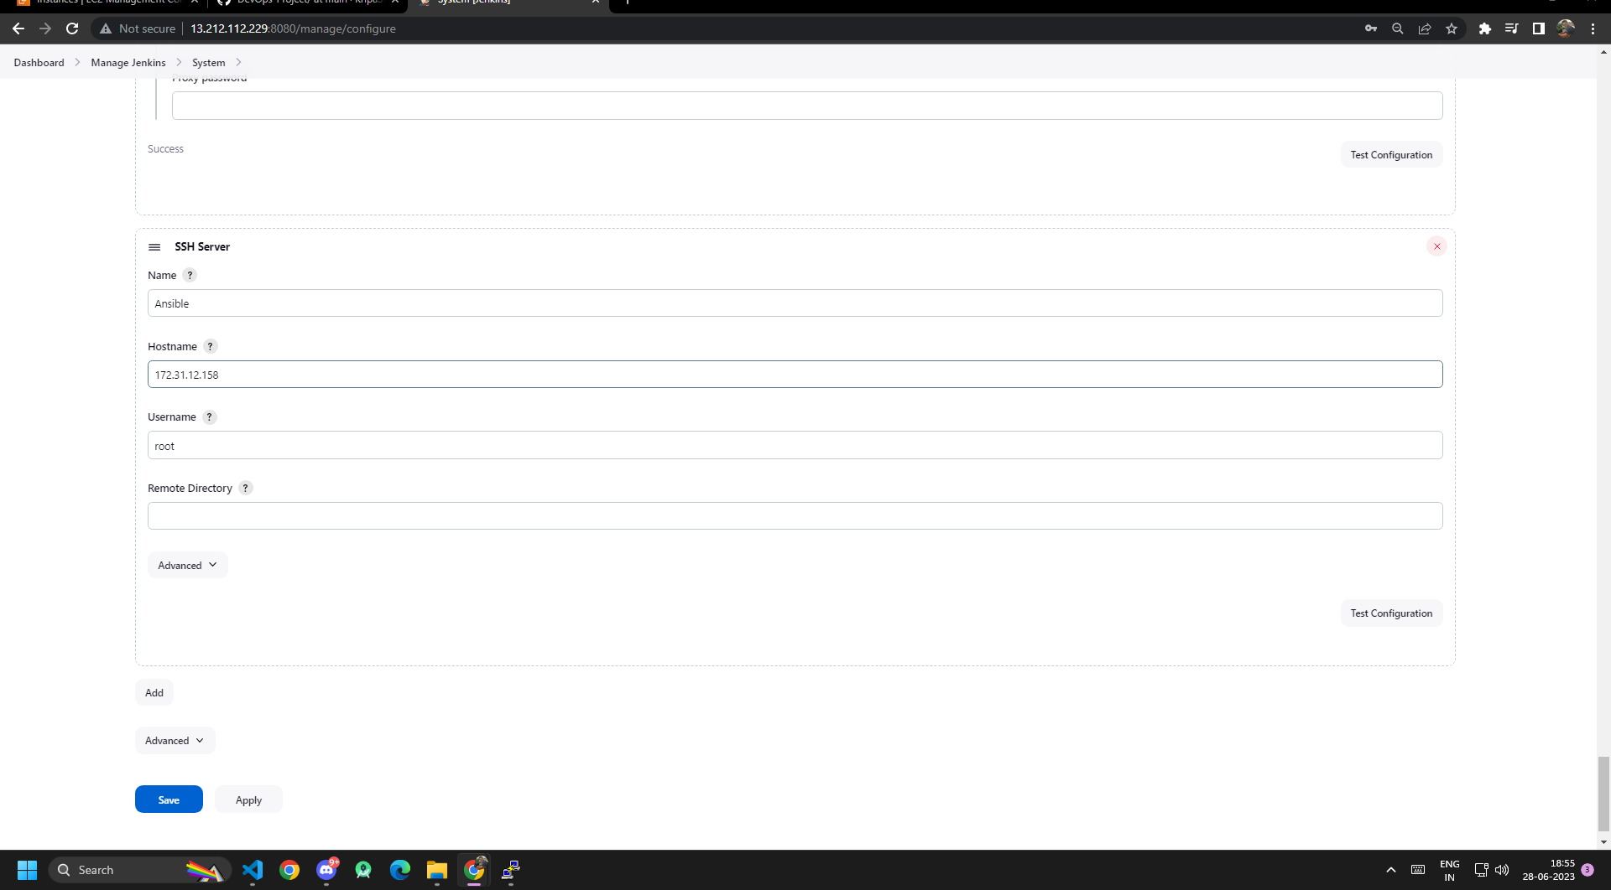
Similarly add Ansible at the SSH server with Host name @ privatekey.

Slide 30
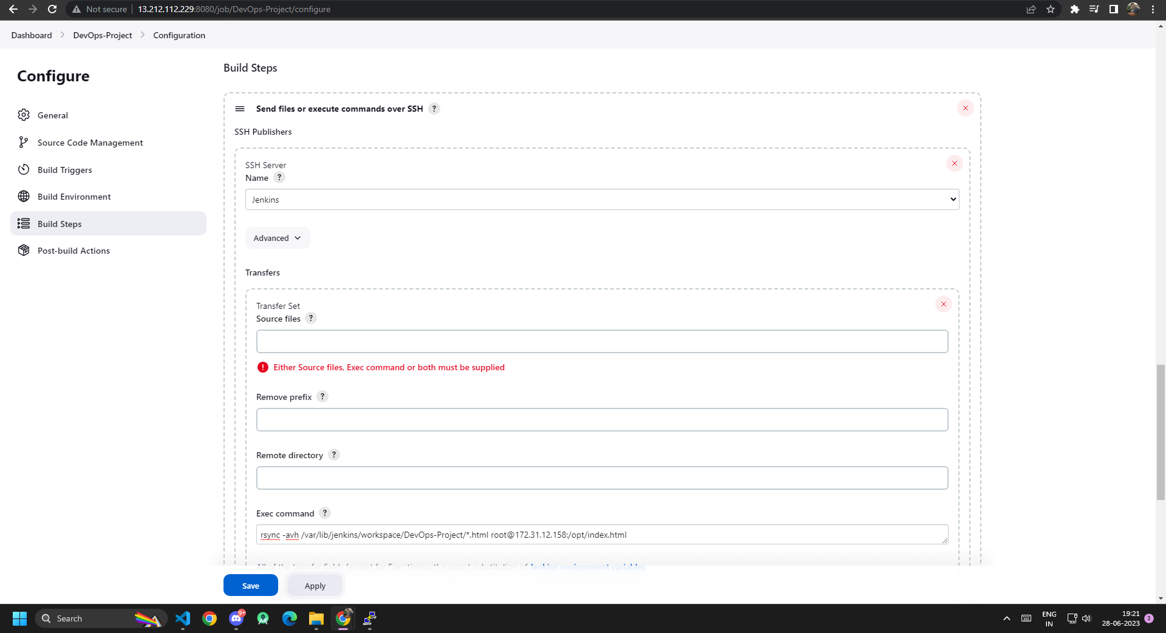
Add Exec – Command to call the repo.

Slide 31
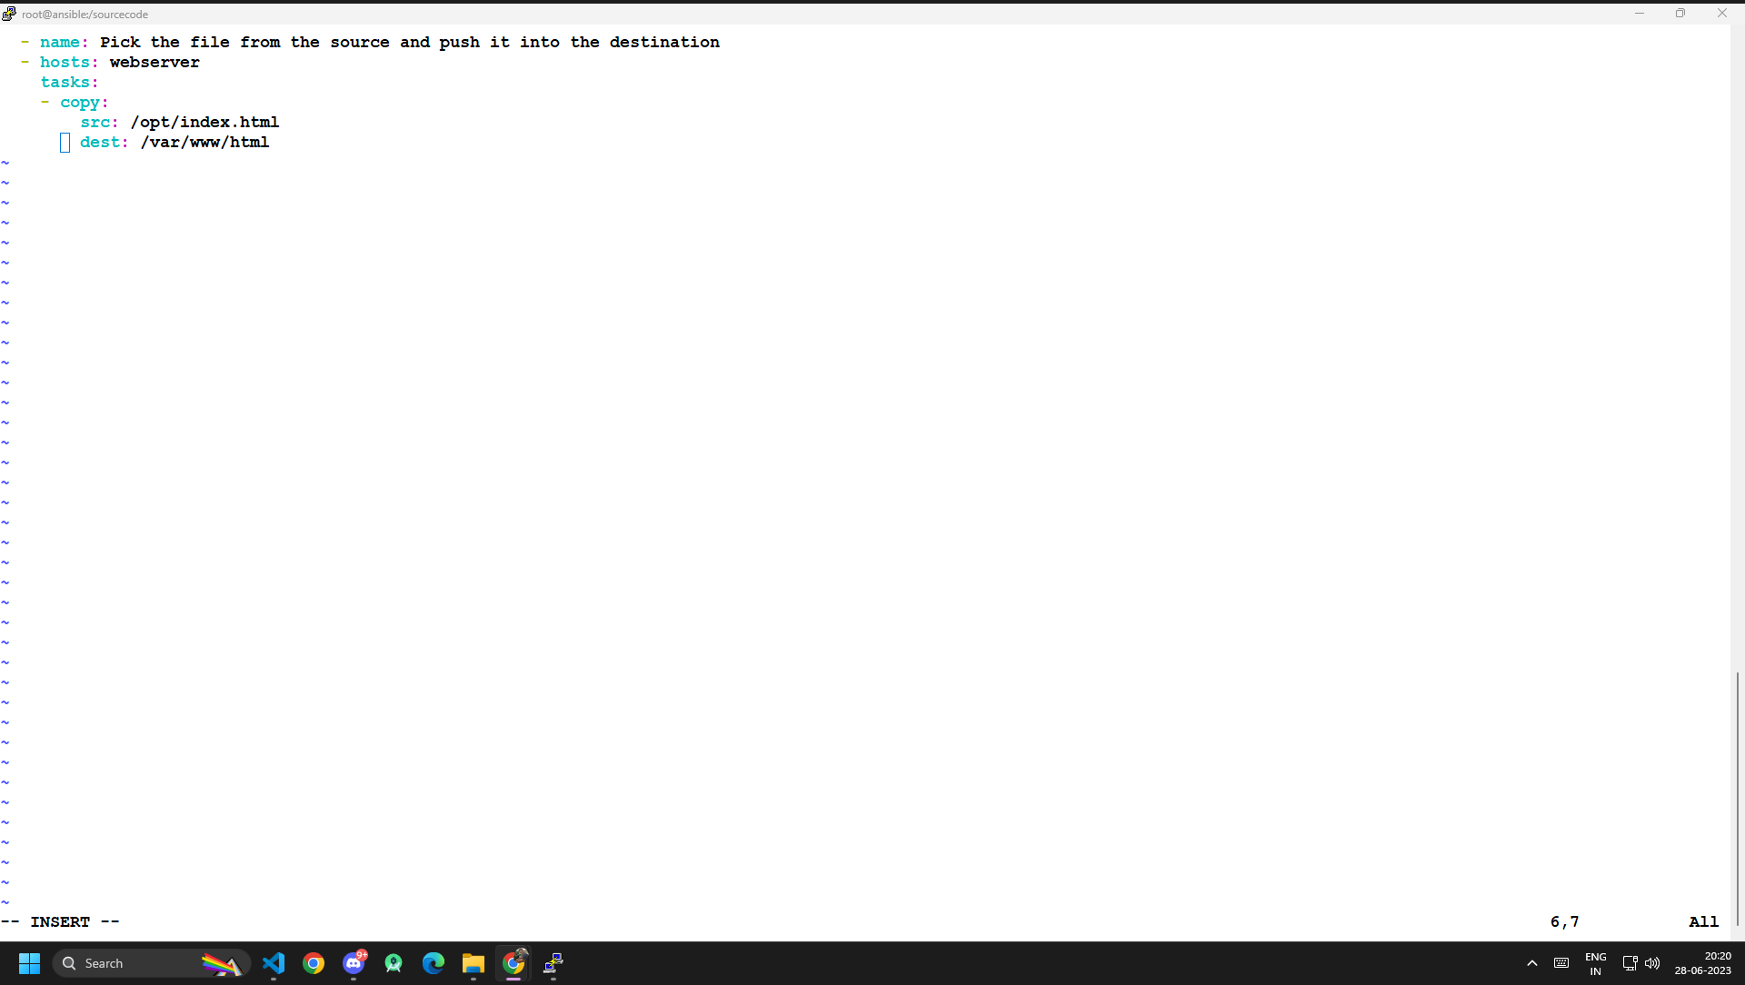
Write the playbook in the Ansible server at the mkdir /sourcecode
named deployment.yal .

Slide 32
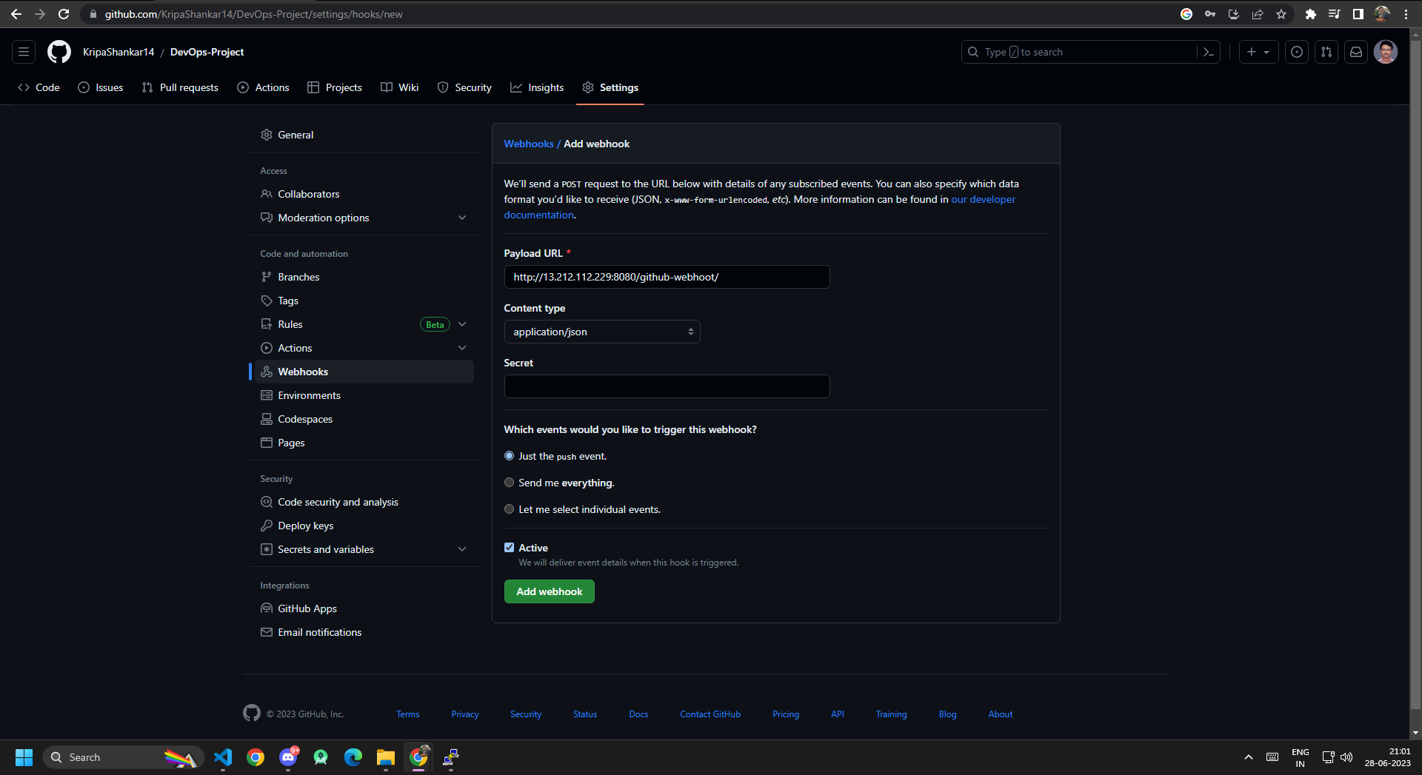
Add Webhook at the git by payloading the url od home screen of jenkins.

Slide 33
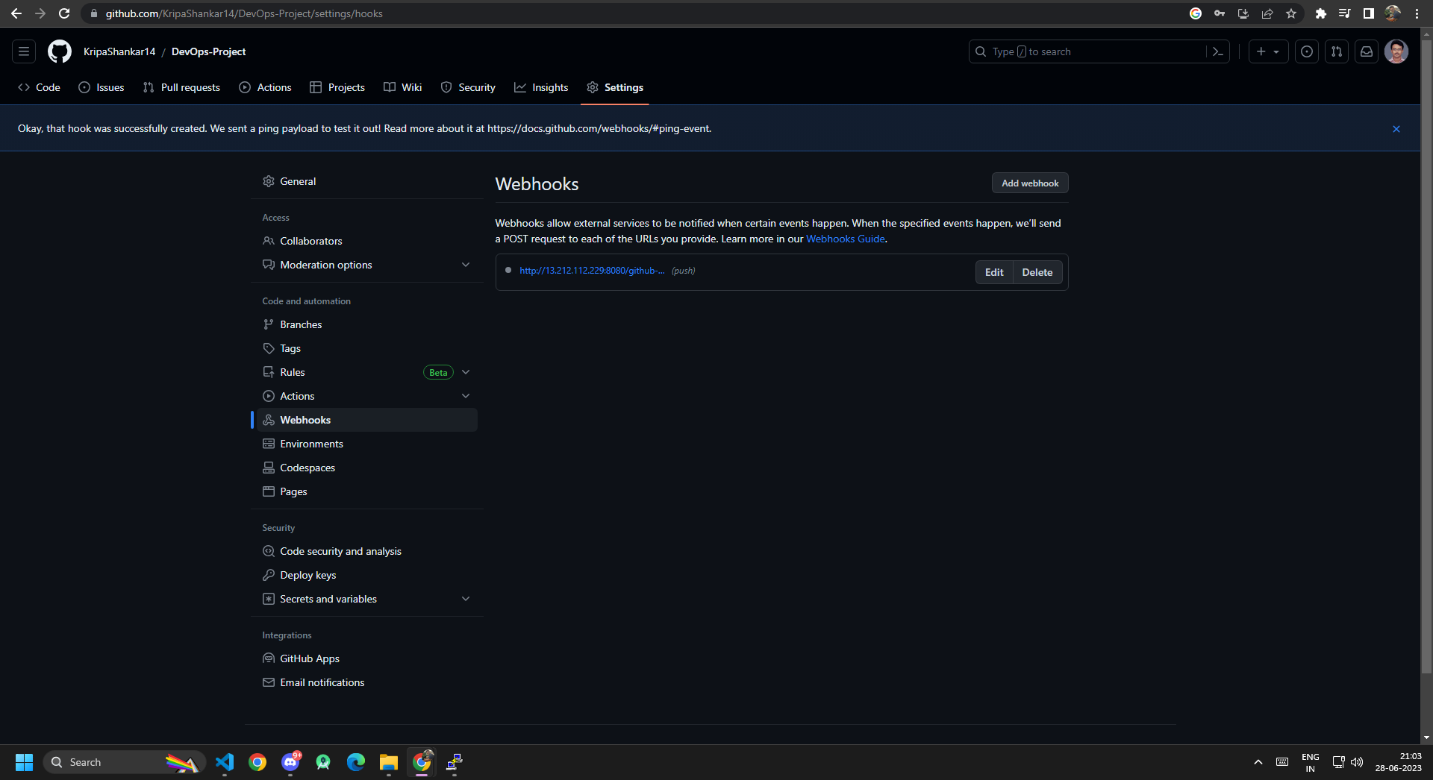
Webhook successfully added.

Slide 34
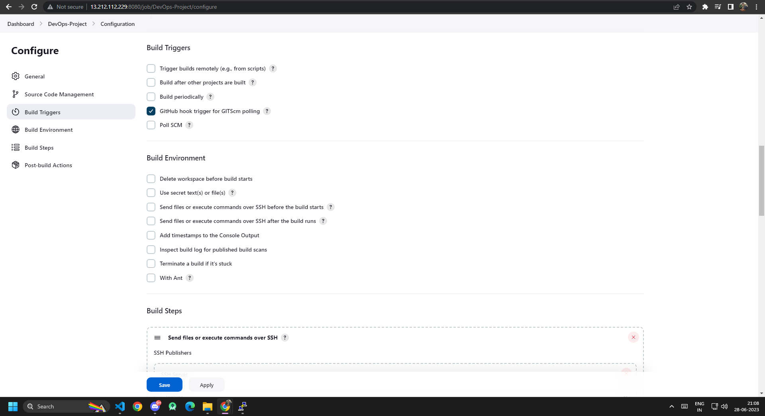
Turn on the GitHub hook trigger.

Slide 35
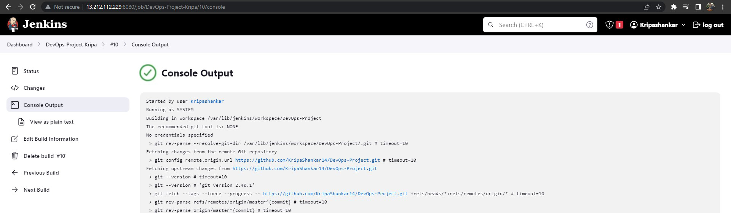

Finally the content in the index.html
has showed up .
This is how the CI/CD pipeline works.

Slide 36
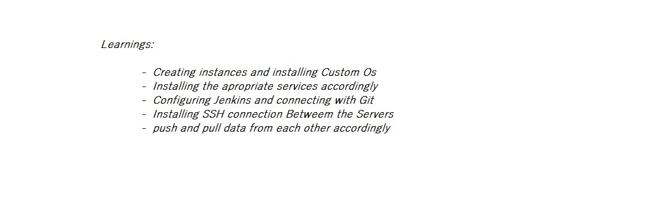
Things Learned From This Project

